Slide 1


Slide 2

Topics
HA Architecture
Netflix - Simian Army Project
HA Architecture – Example
Exam Tips

Slide 3
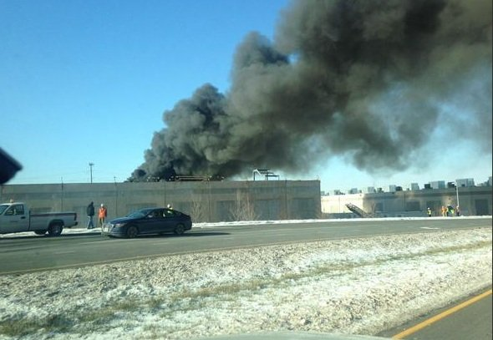
HA Architecture
Everything fails. EVERYTHING
You should always plan for failure.

Slide 4

Simian Army
Netflix - Simian Army Project

Slide 5
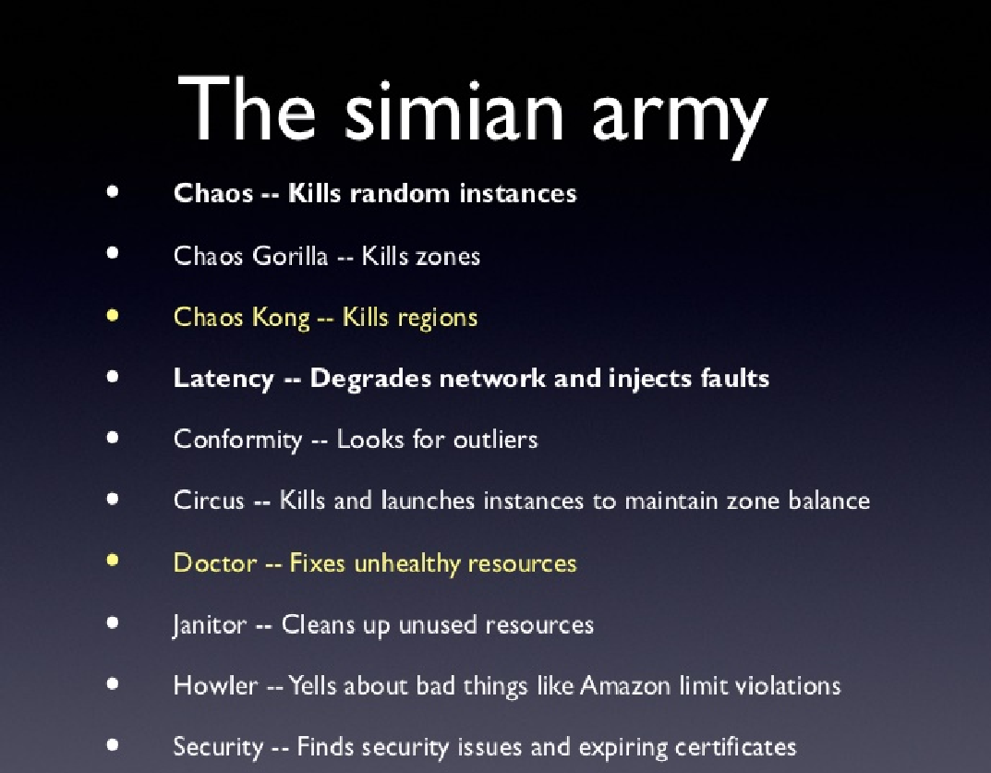
Simian Army

Slide 6
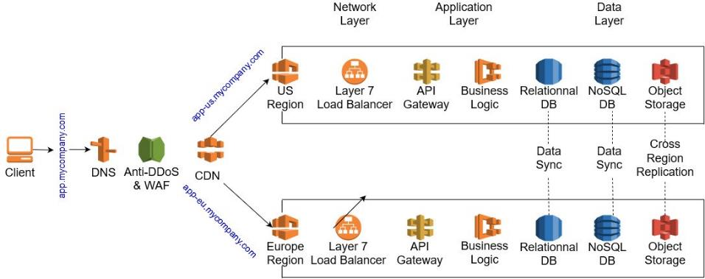
HA Architecture - Example

Slide 7
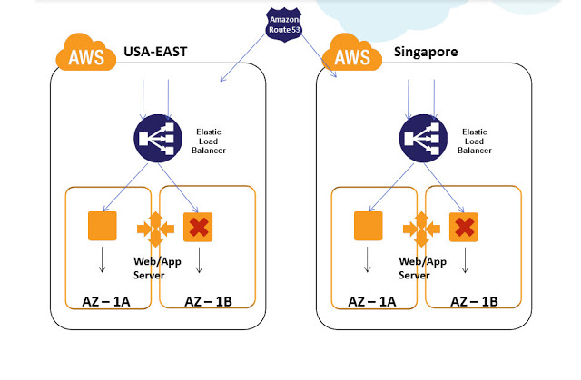
HA Architecture - Example

Slide 8
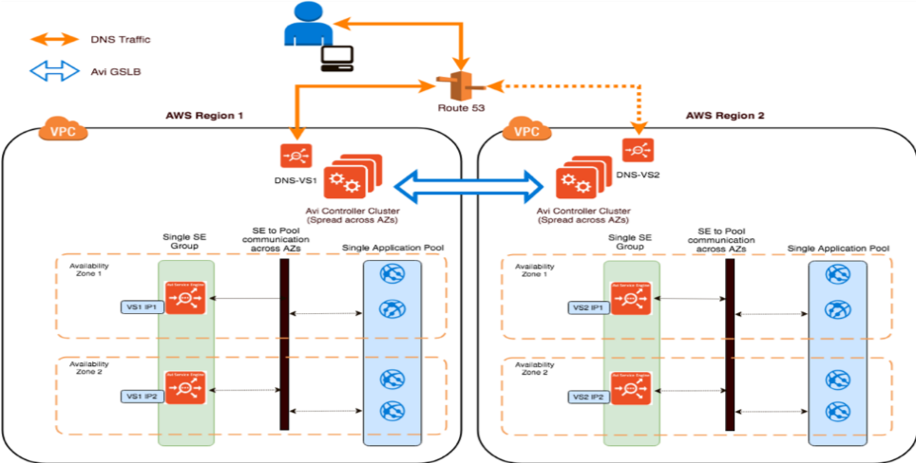
HA Architecture - Example

Slide 9
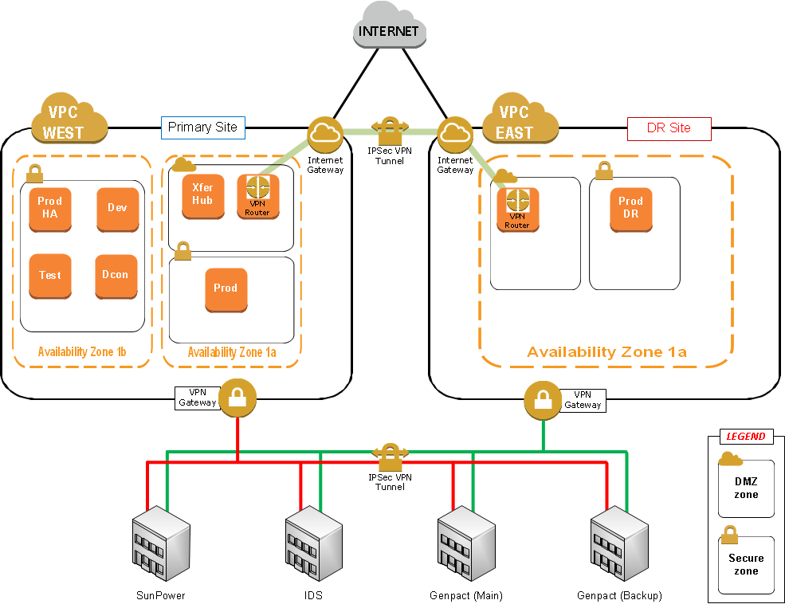
HA Architecture - Example

Slide 10
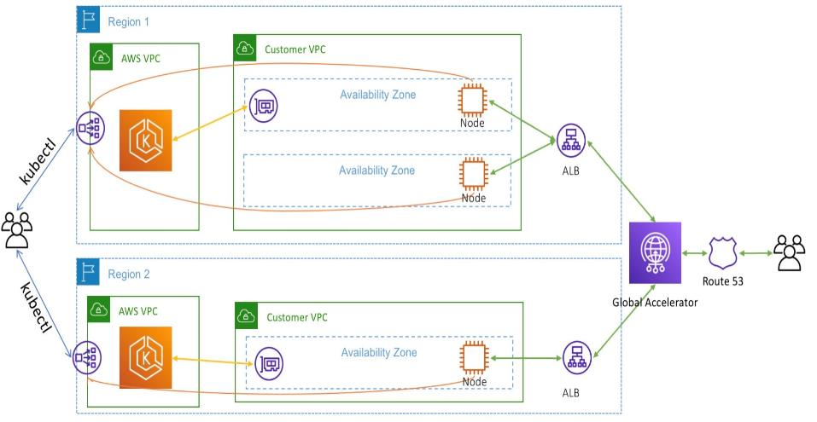
HA Architecture - Example

Slide 11
HA Exam Question
Scenario: You might have a website that requires a minimum of 6 instances and it must be highly available. You must also be able to tolerate the failure of 1 availability zone. What is the ideal architecture for this environment while being the most cost effective ?
2 Availability Zones with 2 instances in each AZ
3 Availability Zones with 3 instances in each AZ
1 Availability Zones with 6 instances in each AZ
3 Availability Zones with 2 instances in each AZ
Answer : 3 Availability Zones with 3 instances in each AZ

Slide 12
HA Exam Tips
Always be designing for failure
Use Multiple AZ's and Multiple regions wherever you can
Know the difference between Multi AZ and Read Replicas for RDS
Know the difference between scaling out and scaling up
Scaling out :- When we use auto scaling groups, and we add additional EC2 instances
Scaling up is where we increase the resources inside our Ec2 instances i.e., go from a t2.micro to t6.xlarge
Read the questions carefully and always consider the cost element
Know the difference S3 storage classes

Slide 13
Thank you

